Slide 1
Classification of hotels for Expedia.
Project in Artificial Intelligence - EDAN70

Slide 2
Introduction
Who we are.
Kaggle.com
Our main problem. Expedia
Random Forest Classifier.
Expedia and workflow.
Conclusions.

Slide 3
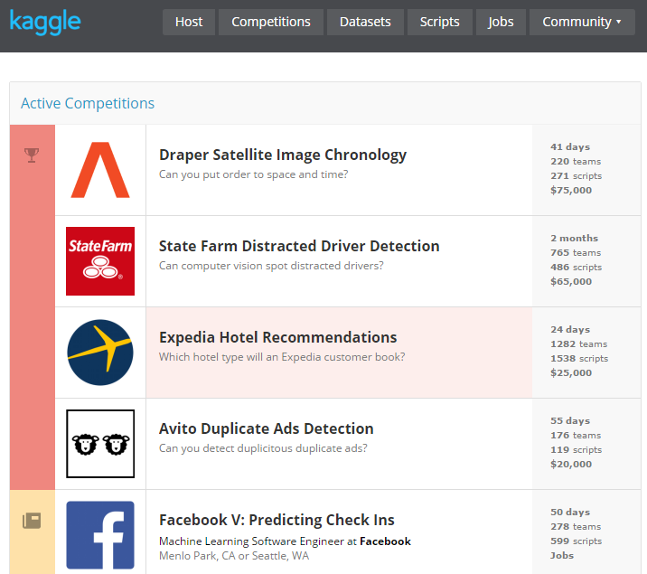
Kaggle.com
Users from all over the world compete to produce the best machine learning models.
Submissions, Scripts, Leaderboards.

Slide 4
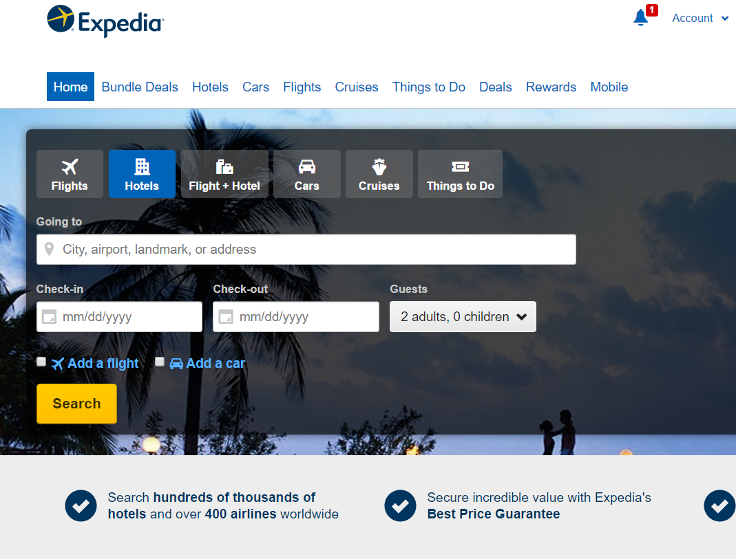
Expedia
The problem – Expedia.
< $60 / night
Central

Slide 5
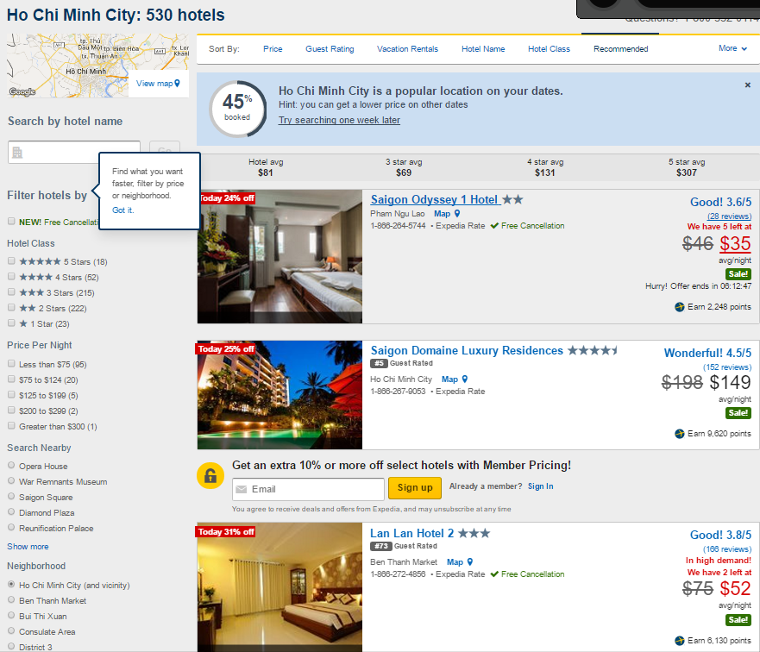

Slide 6
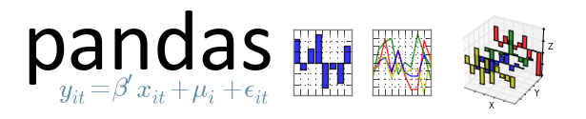


Tools
Python 64-bit
Alot of RAM
Pandas – parsing data into data structures
NumPy – scientific computing package
Scikit learn – Machine Learning library, built on SciPy, NumPy and matplotlib

Slide 7
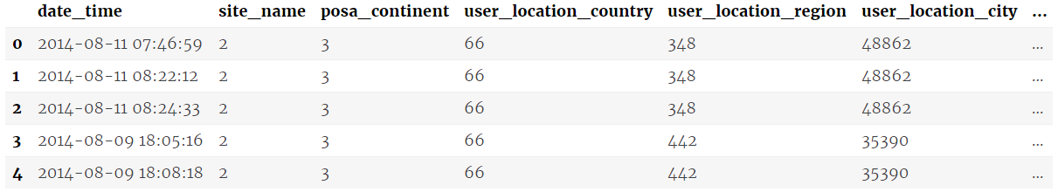
Expedia - dataset
24 column in training
22 column in testing (no is_booking, no hotel_cluster)
Most of the columns are integers or floats
Output hotel cluster ID integer range from 1-99

Slide 8


Expedia - workflow
Understanding dataset
srch_destination_type_id, hotel_continent, hotel_country, and hotel_market
srch_ci srch_co are filled with dates
srch_adults_cnt, srch_children_cnt, and srch_rm_cnt is number of guests and rooms
site_name – Expedia point of sale (Expedia.com, Expedia.se, ...)
Add a flight maps to the is_package field
posa_continent – ID of continent associated with site_name

Slide 9
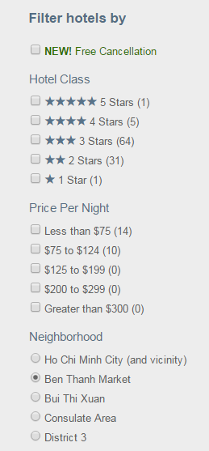
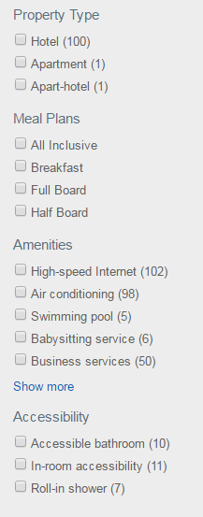
Expedia – Hotel Clusters
{
}
,
,
,
…
Useful! Expedia can much quickier
at an earlier stage filter the hotels
< $60 / night
Central

Slide 10
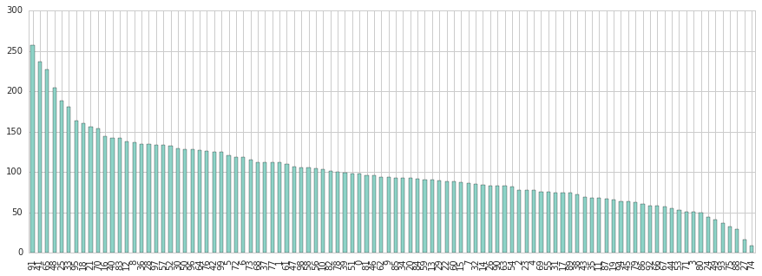
Expedia – most frequent hotel clusters

Slide 11
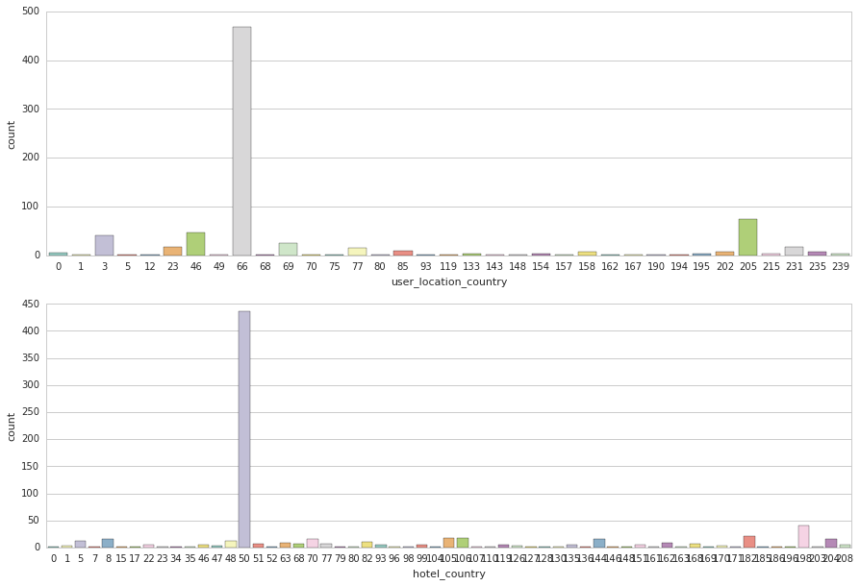
Expedia – examining features
What are the most countries the customer travel from/to?

Slide 12
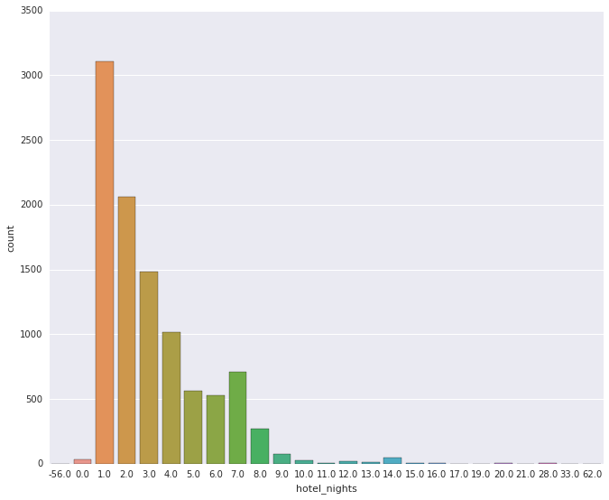
Nights of stay

Slide 13
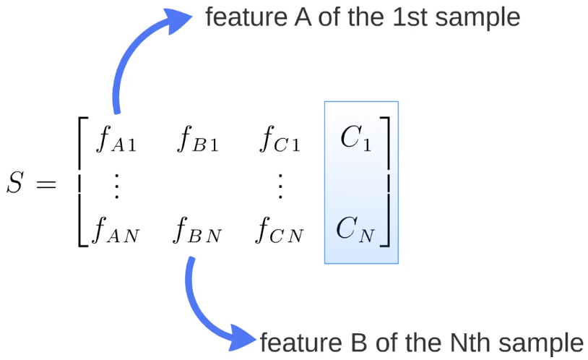
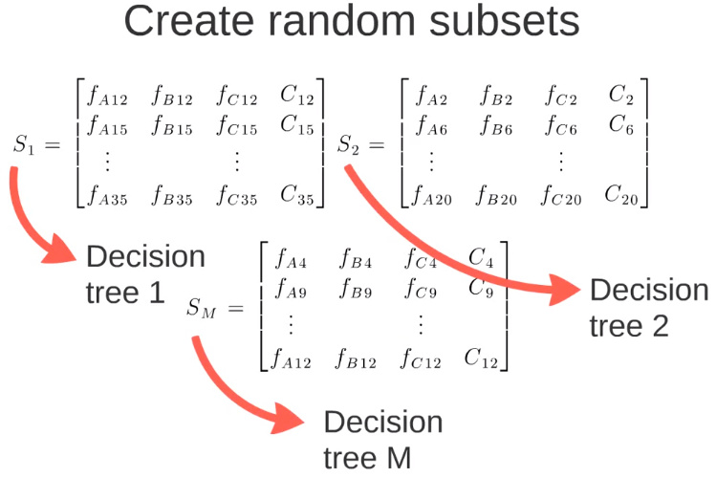
Random Forest Classifier
Supervised learning classifier – Uses bagging methods.
Random sub-samples.
Generates decision trees on each sub-sample.

Slide 14
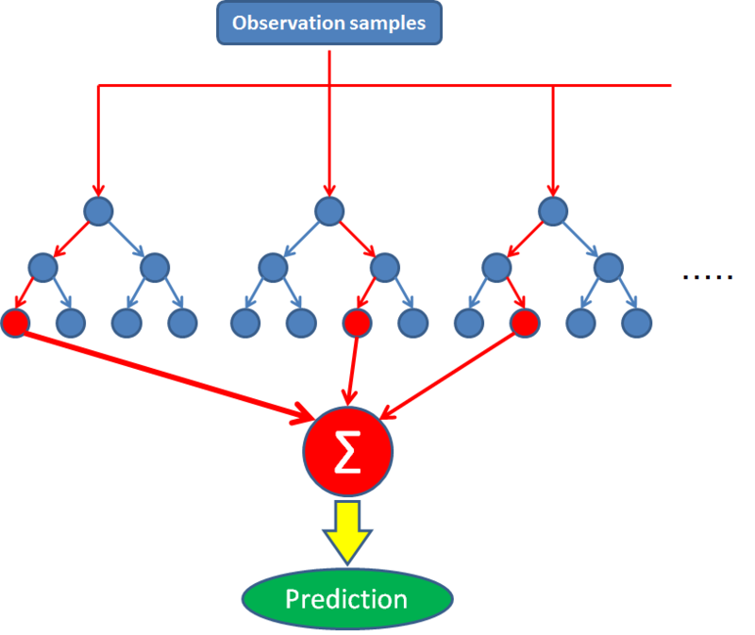
Random Forest Classifier
Sum all the decision trees.
Mistakes are taken care of.
The classifier corrects decision trees habit of overfitting to their training set.

Slide 15
Random Forest Classifier
Why does Random Forest work?
Most trees provide correct predicition for the most part of the data.
Trees make mistake at different place.
C1
C2
C1
C1
C1

Slide 16
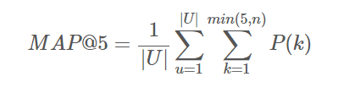
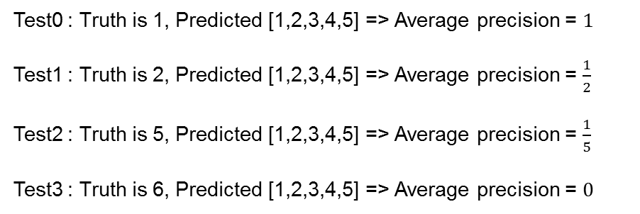
Expedia – How good is the classifer?
We predict 5 hotel clusters for each sample in test.csv
The evaluation function is Mean Average Precision @ 5
Test0 : Truth is 1, Predicted [1,2,3,4,5] => Average precision = $1$
Test1 : Truth is 2, Predicted [1,2,3,4,5] => Average precision = $\frac{1}{2}$
Test2 : Truth is 5, Predicted [1,2,3,4,5] => Average precision = $\frac{1}{5}$
Test3 : Truth is 6, Predicted [1,2,3,4,5] => Average precision = $0$
Mean average precision = 0.425

Slide 17
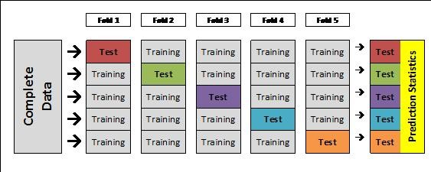
Expedia – How good is the classifer?
k-fold cross-validation for model tuning
We could more easily tune the model with a Grid Search for the best parameters

Slide 18
Expedia - Results
Results with Random Forest classifier:
0.18584
Results with most popular local hotels:
0.30090

Slide 19
Leakage
Train set
Test set
user_location_country, user_location_region, user_location_city, hotel_market and orig_destination_distance

Slide 20
Leakage - Results
Using a more advanced approach with most popular hotels and leakage we got:
0.50050

Slide 21
Expedia - Conclusion
Machine learning can be used in real-life situations to optimize a product or service
It is very important to not leak training examples into the test set because the model will overfit
Here the best model will have to find the leak (1/3) and train itself to catch the rest of the holdout data (2/3)

